Slide 1
Smart Objects: The “Things” in IoT
Module 2

Slide 2
Sensors are fundamental building blocks of IoT networks
Sensors are the foundational elements found in smart objects—the ―things‖in the Internet of Things
Smart objects are any physical objects that contain embedded technology to sense and/or interact with their environment in a meaningful way by being interconnected and enabling communication among themselves or an external agent.

Slide 3
SENSORS, ACTUATORS, AND SMART OBJECTS
Asensor: It senses
More specifically, a sensor measures some physical quantity and converts that measurement reading into a digital representation.
That digital representation is typically passed to another device for transformation into useful data that can be consumed by intelligent devices or humans
Sensors are not limited to human-like sensory data.
They are able to provide an extremely wide spectrum of rich and diverse measurement data with far greater precision than human senses

Slide 4
Categories
Active or passive:
Sensors can be categorized based on whether they produce an energy output and typically require an external power supply (active) or
Whether they simply receive energy and typically require no external power supply (passive).
Invasive or non-invasive:
Sensors can be categorized based on whether a sensor is part of the environment it is measuring (invasive) or
External to it (non-invasive).

Slide 5
Contact or no-contact:
Sensors can be categorized based on whether they require physical contact with what they are measuring (contact) or not (no-contact).
Absolute or relative:
Sensors can be categorized based on whether they measure on an absolute scale (absolute) or based on a difference with a fixed or variable reference value (relative).

Slide 6
Area of application:
Sensors can be categorized based on the specific industry
or vertical where they are being used.
How sensors measure:
Sensors can be categorized based on the physical mechanism used to measure sensory input (for example, thermoelectric,electrochemical,piezoresistive,optic,electric, fluid mechanic, photoelastic).

Slide 7
What sensors measure:
Sensors can be categorized based on their applications
or what physical variables they measure.
Note that this is by no means an exhaustive list, and there are many other classification and taxonomic schemes for sensors, including those based on material, cost, design, and other factors

Slide 8
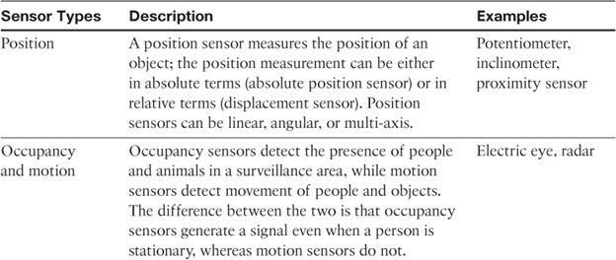
Categorization based on what physical phenomenon a sensor is measuring

Slide 9
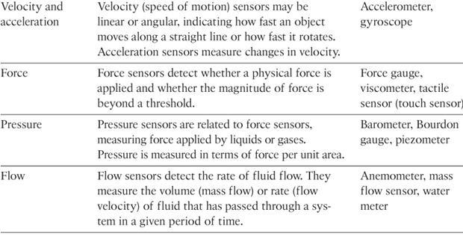
11

Slide 10
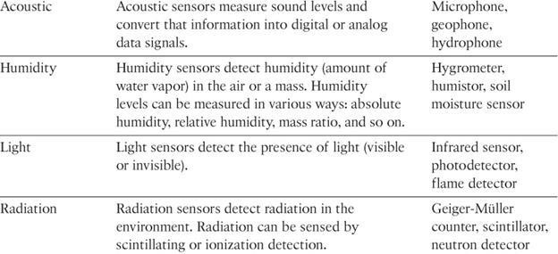

Slide 11
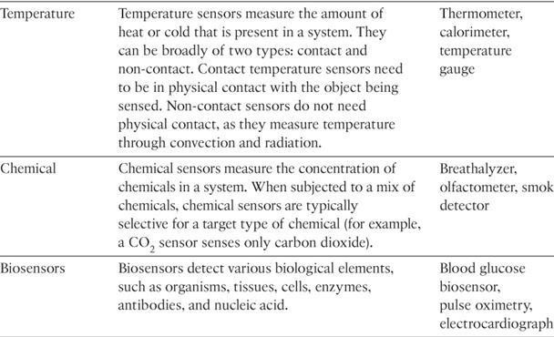

Slide 12
Precision agriculture (smart farming)
Which uses a variety of technical advances to improve the efficiency, sustainability, and profitability of traditional farming practices.
This includes the use of GPS and satellite aerial imagery for determining field viability; robotsforhigh-precision planting, harvesting, irrigation, and soon; and real- time analytics and artificial intelligence to predict optimal crop yield, weather impacts, and soil quality.
Among the most significant impacts of precision agriculture are those dealing with sensor measurement of a variety of soil characteristics. These include real- time measurement of soil quality, pH levels, salinity, toxicity levels, moisture levels for irrigation planning, nutrient levels for fertilization planning, and soon.
All this detailed sensor data can be analyzed to provide highly valuable and
actionable insight to boost productivity and crop yield.

Slide 13
IoT Use Case: Area of precision agriculture (smart farming)
biodegradable, passive microsensors to measure soil and crop and conditions
.
These sensors, developed at North Dakota State University (NDSU), can be planted directly in the soil and left in the ground to biodegrade without any harm to soil quality.

Slide 14
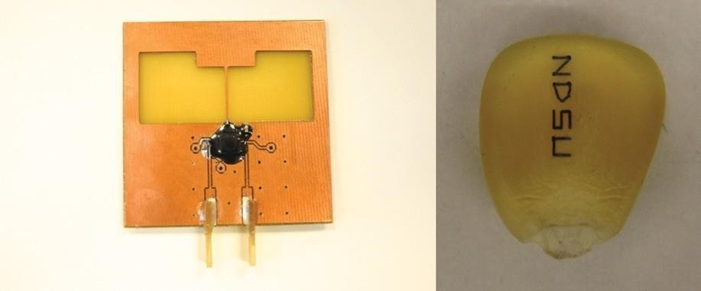
Figure 3-1 Biodegradable Sensors Developed by NDSU for Smart Farming

Slide 15
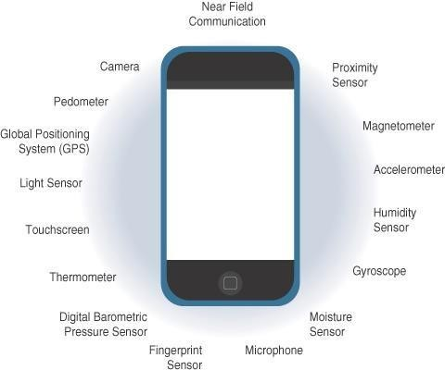
Sensors in a Smart Phone

Slide 16
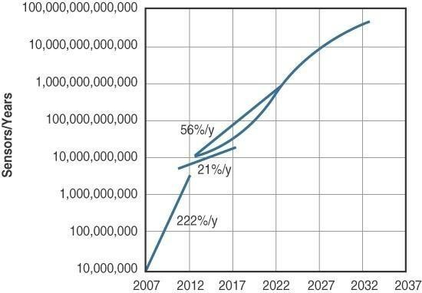
Figure 3-3 Growth and Predictions in the Number of Sensors

Slide 17
Actuators
Actuators are natural complements to sensors
Sensors are designed to sense and measure practically any measurable variable in the physical world.
They convert their measurements (typically analog) into electric signals or digital representations that can be consumed by an intelligent agent (a device or a human).
Actuators, on the others hand, receive some type of control signal (commonly an electric signal or digital command) that triggers a physical effect, usually some type of motion, force, and so on.
Sensors provide the information,actuators provide the action

Slide 18
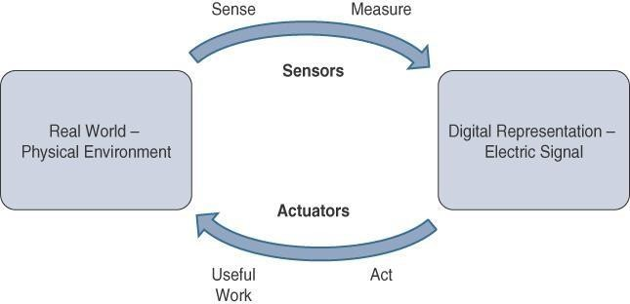

Slide 19
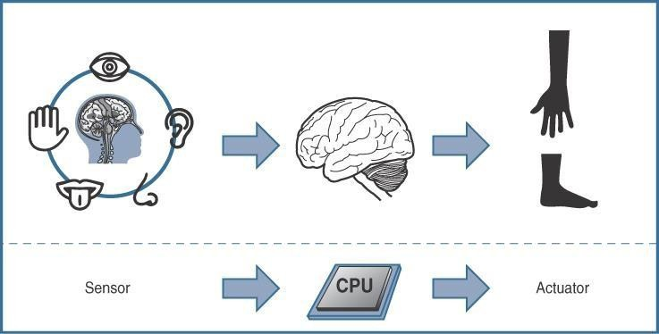

Slide 20
Actuators also vary greatly in function, size, design, and so on.
Some common ways that they can be classified include the following:
Type of motion: Actuators can be classified based on the type of motion they produce (for example, linear, rotary, one/two/three- axes).
Power: Actuators can be classified based on their power output (for example, high power, low power, micro power)
Binary or continuous: Actuators can be classified based on the
number of stable-state outputs.
Area of application: Actuators can be classified based on the specific industry or vertical where they are used.
Type of energy: Actuators can be classified based on their
energy type.

Slide 21
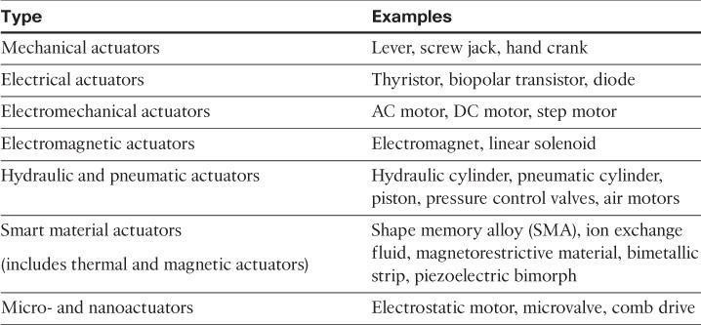
Classification based on energy type

Slide 22
Micro-Electro-Mechanical Systems (MEMS)
Interesting advances in sensor and actuator technologies is in how they are packaged and deployed.
Micro-electro-mechanical systems (MEMS), sometimes simply referred to as micro-machines, can integrate and combine electric and mechanical elements, such as sensors and actuators, on a very small (millimeter or less) scale.
One of the keys to this technology is a microfabrication technique that is similar to what is used for microelectronic integrated circuits.
This approach allows mass production at very low costs

Slide 23
The combination of tiny size, low cost, and the ability to mass produce makes MEMS an attractive option for a huge number of IoT applications.
MEMS devices have already been widely used in a variety of different applications and can be found in very familiar everyday devices.
For example, inkjet printers use micropump MEMS.
Smart phones also use MEMS technologies for things like accelerometers and gyroscopes.
In fact, automobiles were among the first to commercially introduce MEMS into the mass market, with airbag accelerometers.

Slide 24
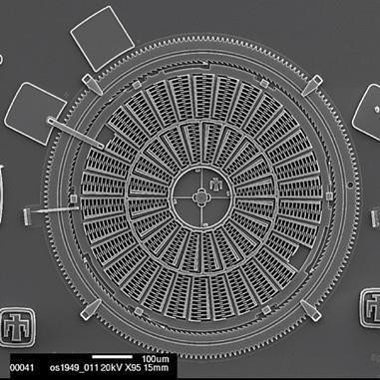
Figure 3-6 Torsional Ratcheting Actuator (TRA) MEMS (Courtesy Sandia National Laboratories, SUMMiT™ Technologies, www.sandia.gov/mstc.)

Slide 25
Smart Objects
Smart objects are, quite simply, the building blocks of IoT.
They are what transform everyday objects into a network of intelligent objects that are able to learn from and interact with their environment in a meaningful way
The real power of smart objects in IoT comes from being networked together rather than being isolated as standalone objects

Slide 26
If a sensor is a standalone device that simply measures the humidity of the soil, it is interesting and useful, but it isn’t revolutionary
If that same sensor is connected as part of an intelligent network that is able to coordinate intelligently with actuators to trigger irrigation systems as needed based on those sensor readings, we have something far more powerful
Extending that even further, imagine that the coordinated sensor/actuator set is intelligently interconnected with other sensor/actuator sets to further coordinate fertilization, pest control,and so on—and even communicate with an intelligent backend to calculate crop yield potential

Slide 27
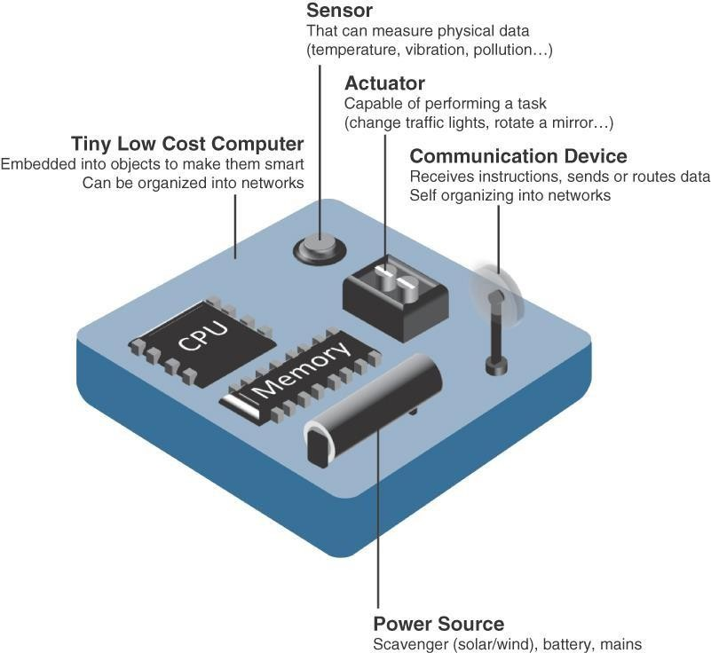
Asmart object, is a device that has, at a minimum, the following four defining characteristics

Slide 28
Processing unit:
Some type of processing unit for
Acquiring data,
Processing and analyzing sensing information received by the sensor(s),
Coordinating control signals to any actuators, and
Controlling a variety of functions on the smart object, including the communication and power systems
The most common is a microcontroller because of its small form factor, flexibility, programming simplicity, ubiquity, low power consumption, and low cost

Slide 29
Sensor(s) and/or actuator(s):
Asmart object is capable of interacting with the physical world through sensors and actuators
Communication device:
The communication unit is responsible for connecting a smart object with other smart objects and the outside world (via the network).
Communication devices for smart objects can be either
wired or wireless

Slide 30
Power source:
Smart objects have components that need to be powered.
The most significant power consumption usually comes from the communication unit of a smart object

Slide 31
Trends in Smart Objects
Size is decreasing
Power consumption is decreasing
Processing power is increasing
Communication capabilities are improving
Communication is being increasingly standardized

Slide 32
SENSOR NETWORKS
A sensor/actuator network (SANET), is a network of sensors that sense and measure their environment and/or actuators that act on their environment
The sensors and/or actuators in a SANET are capable of communicating and cooperating

Slide 33
SANETs offer highly coordinated sensing and actuation capabilities.
Smart homes are a type of SANET that display this coordination between distributed sensors and actuators
For example, smart homes can have temperature sensors that are strategically networked with heating, ventilation, and air-conditioning (HVAC) actuators.
When a sensor detects a specified temperature, this can trigger an actuator to take action and heat or cool the home as needed.

Slide 34
Advantages:
Advantages and disadvantages that a wireless-based solution offers:
Greater deployment flexibility
Simpler scaling to a large number of nodes
Lower implementation costs
Easier long-term maintenance
Effortless introduction of new sensor/actuator nodes
Better equipped to handle dynamic/rapid topology changes
Disadvantages:
Potentially less secure (for example, hijacked access points)
Typically lower transmission speeds
Greater level of impact/influence by environment

Slide 35
Wireless Sensor Networks (WSNs)
Wireless sensor networks are made up of wirelessly connected smart objects, which are sometimes referred to as motes.
The fact that there is no infrastructure to consider withWSNs is surely a powerful advantage for flexible deployments, but there are a variety of design constraints to consider with these wirelessly connected smart objects

Slide 36
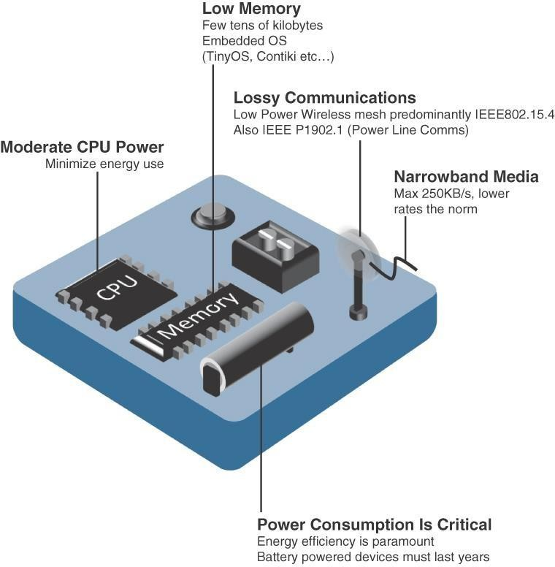

Slide 37
The following are some of the most significant limitations of the smart objects inWSNs:
Limited processing power
Limited memory
Lossy communication
Limited transmission speeds
Limited power
Note
Smart objects with limited processing, memory, power, and so on are often referred to as constrained nodes.

Slide 38
Such large numbers of sensors permit the introduction of hierarchies of smart objects.
Such a hierarchy provides, among other organizational advantages, the ability to aggregate similar sensor readings from sensor nodes that are in close proximity to each other

Slide 39
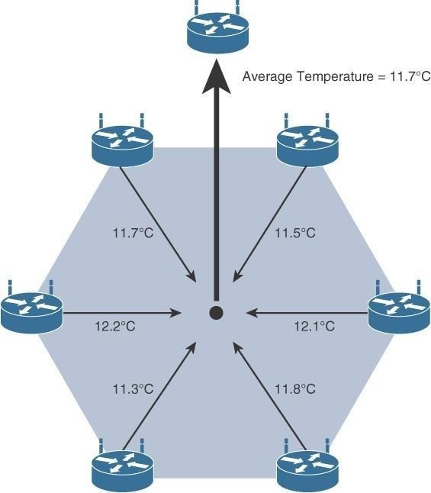
. Figure 3-9 shows an example of such a data aggregation function in a WSN where temperature readings from a logical grouping of temperature sensors are aggregated as an average temperature reading.
Figure 3-9 Data Aggregation in Wireless Sensor Networks

Slide 40
These data aggregation techniques are helpful in reducing the amount of overall traffic (and energy) inWSNs with very large numbers of deployed smart objects.
This data aggregation at the network edges is where fog and mist computing are critical IoT architectural elements needed to deliver the scale and performance required by so many IoT use cases

Slide 41
Wirelessly connected smart objects generally have one of the
following two communication patterns:
Event-driven:
Transmission of sensory information is triggered only when a smart object detects a particular event or predetermined threshold.
Periodic:
Transmission of sensory information occurs only at periodic intervals.
The decision of which of these communication schemes is used depends
greatly on the specific application
For example:medical use cases

Slide 42
Communication Protocols for Wireless Sensor Networks
There are literally thousands of different types of sensors and actuators.
WSNs are becoming increasingly heterogeneous, with more sophisticated interactions.
Any communication protocol must be able to scale to a large number of nodes.
Likewise, when selecting a communication protocol, you must carefully take into account the requirements of the specific application and consider any trade-offs the communication
protocol offers
between power consumption, maximum
transmission speed, range, tolerance for packet loss, topology optimization, security, and so on

Slide 43
They must also enable, as needed, the overlay of autonomous techniques (for example, self-organization, self-healing, self- configuration)
Wireless sensor networks interact with their environment. Sensors often produce large amounts of sensing and measurement data that needs to be processed. This data can be processed locally by the nodes of aWSN or across zero or more hierarchical levels in IoT networks.
Communication protocols need to facilitate routing and message handling for this data flow between sensor nodes as well as from sensor nodes to optional gateways, edge compute, or centralized cloud compute

Slide 44
Chapter 4- Smart Objects
IoT devices and sensors must be connected to the network for their data to be utilized.
In addition to the wide range of sensors, actuators, and smart objects that make up IoT, there are also a number of different protocols used to connect them

Slide 45
COMMUNICATIONS CRITERIA
The characteristics and attributes you should consider when selecting and dealing with connecting smart objects
Range
Frequency Bands:
Power Consumption:
Topology
Constrained Devices:
Constrained-Node Networks:

Slide 46
Range
How far does the signal need to be propagated?
That is, what will be the area of coverage for a selected wireless technology?
Should indoor versus outdoor deployments be differentiated?

Slide 47
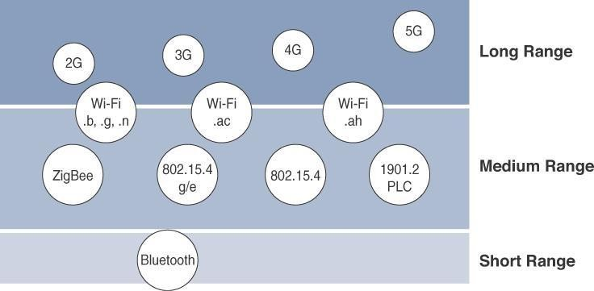

Slide 48
Short range:
The classical wired example is a serial cable.
Wireless short-range technologies are often considered as an alternative to a serial cable, supporting tens of meters of maximum distance between two devices.
Examples of short-range wireless technologies are IEEE
802.15.1 Bluetooth and IEEE802.15.7Visible Light Communications (VLC)

Slide 49
Medium range:
This range is the main category of IoT access technologies.
In the range of tens to hundreds of meters, many specifications and implementations are available.
The maximum distance is generally less than 1 mile between two devices
Examples of medium-range wireless technologies include IEEE 802.11Wi-Fi, IEEE 802.15.4, and 802.15.4gWPAN.
Wired technologies such as IEEE 802.3 Ethernet and IEEE 1901.2 Narrowband Power Line Communications (PLC)

Slide 50
Long range:
Distances greater than 1 mile between two devices require long-range technologies.
Wireless examples are cellular (2G, 3G, 4G) and some applications of outdoor IEEE 802.11Wi-Fi and Low-Power Wide-Area (LPWA) technologies.
LPWAcommunications have the ability to communicateoveralarge area without consuming much power. These technologies are therefore ideal for battery-powered IoT sensors

Slide 51
Frequency Bands
Radio spectrum is regulated by countries and/or organizations, such as the International Telecommunication Union (ITU) and the Federal Communications Commission (FCC).
These groups define the regulations and transmission requirements for various frequency bands
For example, portions of the spectrum are allocated to types of telecommunications such as radio, television, military, and so on.

Slide 52
Focusing on IoT access technologies, the frequency bands leveraged by wireless communications are split between licensed and unlicensed bands.
Licensed spectrum is generally applicable to IoT long- range access technologies
In order to utilize licensed spectrum, users must subscribe to services when connecting their IoT devices
In exchange for the subscription fee, the network operator can guarantee the exclusivity of the frequency usage over the target area and can therefore sell a better guarantee of service.

Slide 53
The ITU has also defined unlicensed spectrum for the industrial, scientific, and medical (ISM) portions of the radio bands.
These frequencies are used in many communications
technologies for short-range devices (SRDs).
Unlicensed means that no guarantees or protections are offered in the ISM bands for device communications
ISM bands for IoT access
2.4 GHz band as used by IEEE 802.11b/g/n Wi-Fi
IEEE 802.15.1 Bluetooth
IEEE 802.15.4WPAN

Slide 54
Unlicensed spectrum is usually simpler to deploy than licensed because it does not require a service provider.
However, it can suffer from more interference because other devices may be competing for the same frequency in a specific area
The frequency of transmission directly impacts how a signal propagates and its practical maximum range.

Slide 55
Power Consumption
Powered nodes and battery-powered nodes
A powered node has a direct connection to a power source, and communications are usually not limited by power consumption criteria.
However, ease of deployment of powered nodes is limited by the availability of a power source, which makes mobility more complex
Battery-powered nodes bring much more flexibility to IoT devices.
These nodes are often classified by the required lifetimes of their batteries.

Slide 56
For battery-powered
nodes, IoT wireless access
technologies must address the needs of low power consumption and connectivity
Anew wireless environment known as Low-Power Wide- Area (LPWA)
Battery-powered nodes are often placed in a “sleep mode” to preserve battery life when not transmitting
Wired IoT access technologies consisting of powered nodes are not exempt from power optimization

Slide 57
Topology
Among the access technologies available for connecting IoT devices, three main topology schemes are dominant: star, mesh, and peer-to-peer
For long-range and short-range technologies, a star topology is prevalent
Star topologies utilize a single central base station or controller to allow communications with endpoints
For medium-range technologies, a star, peer-to-peer, or mesh topology is common
Peer-to-peer topologies allow any device to communicate with any other device as long as they are in range of each other

Slide 58
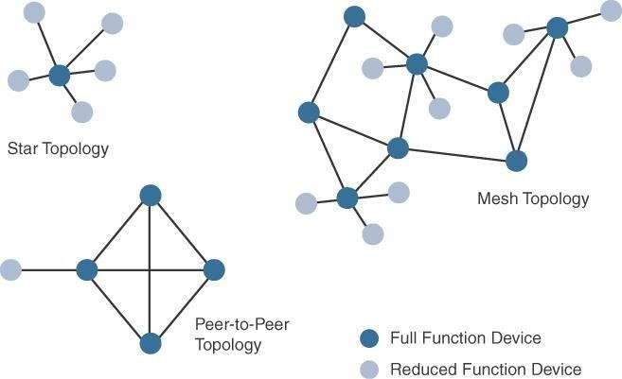
Ex: IndoorWi-Fi deployments and OutdoorWi-Fi deployments

Slide 59
IEEE 802.15.4 and 802.15.4g RF, IEEE 1901.2a PLC,
LPWA, and IEEE 802.11ah access technologies
Constrained-Node Networks
Constrained-node networks are often referred to as low-power and lossy networks (LLNs).
Low power – battery powered constraints
Lossy network -- network performance may suffer from interference and variability due to harsh radio environments
Protocols that can be used for constrained-node networks must be evaluated in the context of the following characteristics: data rate and throughput, latency and determinism, and overhead and payload.

Slide 60
Data Rate and Throughput
The data rates available from IoT access technologies range from 100 bps with protocols such as Sigfox (wireless networks to connect low-power objects such as electricity meters and smartwatches, which need to be continuously on and emitting small amounts of data.) to tens of megabits per second with technologies.However, the actual throughput is less
Therefore, understanding the bandwidth requirements of a particular technology, its applicability to given use cases, the capacity planning rules, and the expected real throughput are important for proper network design and successful production deployment

Slide 61
Latency and Determinism
Latency expectations of IoT applications should be known when selecting an access technology
This is particularly true for wireless networks, where packet loss and retransmissions due to interference, collisions,and noise are normal behaviors
On constrained networks, latency may range from a few milliseconds to seconds, and applications and protocol stacks must cope with these wide-ranging values

Slide 62
Overhead and Payload
When considering constrained access network technologies, it is important to review the MAC payload size characteristics required by applications
You should be aware of any requirements for IP.
The minimum IPv6 MTU size is expected to be 1280 bytes.
Therefore, the fragmentation of the IPv6 payload has to be taken into account by link layer access protocols with smaller MTUs

Slide 63
IoT Access Technologies
The following topics are addressed for each IoT access technology:
Standardization and alliances:
The standards bodies that maintain the protocols for a technology
Physical layer:
The wired or wireless methods and relevant frequencies
MAC layer:
Considerations at the MediaAccess Control (MAC) layer, which bridges the physical layer with data link control
Topology:
The topologies supported by the technology
Security:
Security aspects of the technology
Competitive technologies:
Other technologies that are similar and may be suitable alternatives to the given technology

Slide 64
IoT Access Technologies
IEEE 802.15.4
IEEE 802.15.4g and 802.15.4e
IEEE 1901.2a
IEEE 802.11ah
LoRaWAN
NB-IoT and other LTEVariations

Slide 65
IEEE 802.15.4
Wireless access technology for low-cost and low-data-rate devices that are powered or run on batteries
This access technology enables easy installation while remaining both simple and flexible
IEEE802.15.4 is commonly found in the following types of deployments:
Home and building automation
Automotive networks
Industrial wireless sensor networks
Interactive toys and remote controls

Slide 66
Drawbacks of this includes MACreliability, unbounded latency, and susceptibility to interference and multipath fading
The negatives around reliability and latency often have to do with the Collision Sense MultipleAccess/CollisionAvoidance (CSMA/CA) algorithm.
CSMA/CA is an access method in which a device ―listens to make sure no other devices are transmitting before starting its own transmission.
If another device is transmitting, a wait time (which is usually random) occurs before ―listening occurs again
Interference and multipath fading occur with IEEE 802.15.4 because it lacks a frequency-hopping technique

Slide 67
Standardization and Alliances
IEEE 802.15.4 or IEEE 802.15Task Group 4 defines low- data-rate PHY and MAC layer specifications for wireless personal area networks (WPAN).
This is a well-known solution for low complexity wireless devices with low data rates that need many months or even years of battery life.
IEEE 802.15.4-2003 , 802.15.4-2006 , 802.15.4-2011 and
802.15.4-2015

Slide 68
The main areas where ZigBee is the most well-known include automation for commercial, retail, and home applications and smart energy
In the industrial and commercial automation space, ZigBee- based devices can handle various functions, from measuring temperature and humidity to tracking assets.
For home automation, ZigBee can control lighting, ZigBee Smart Energy brings together a variety of interoperable products, such as smart meters, that can monitor and control the use and delivery of utilities, such as electricity and water

Slide 69
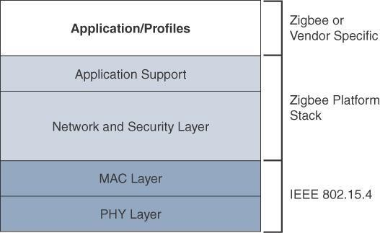
The traditional ZigBee stack

Slide 70
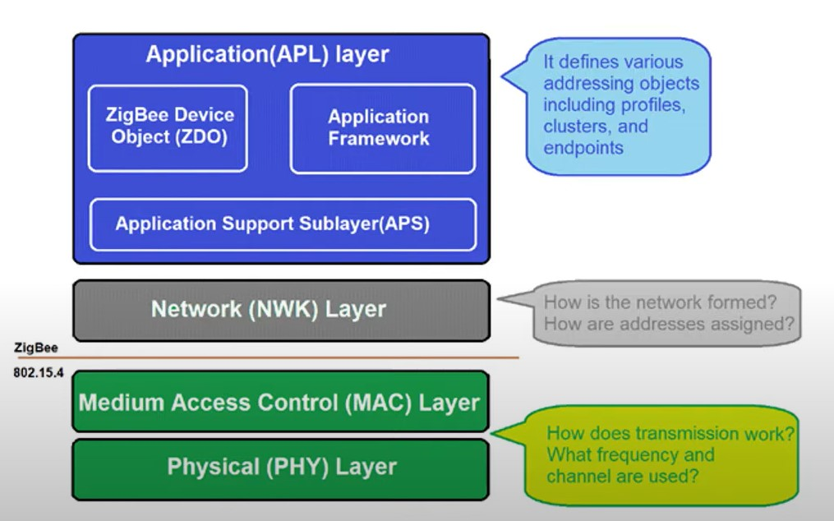

Slide 71
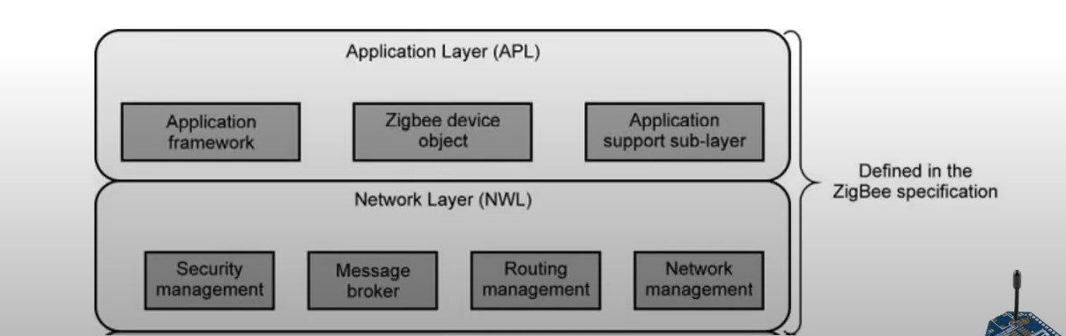

Slide 72
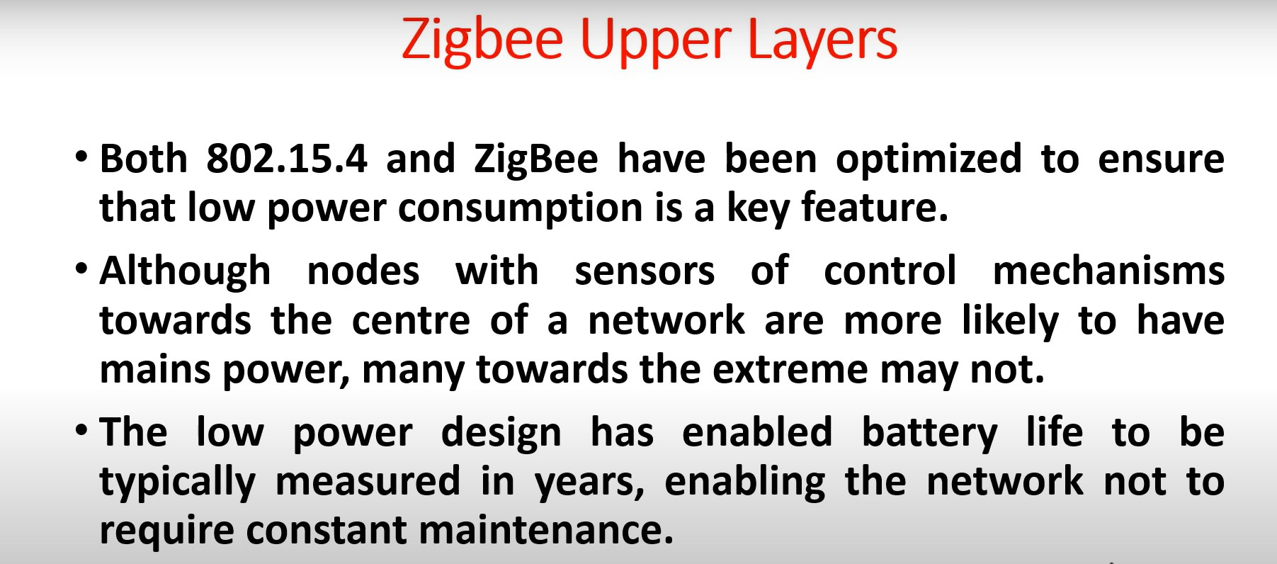

Slide 73
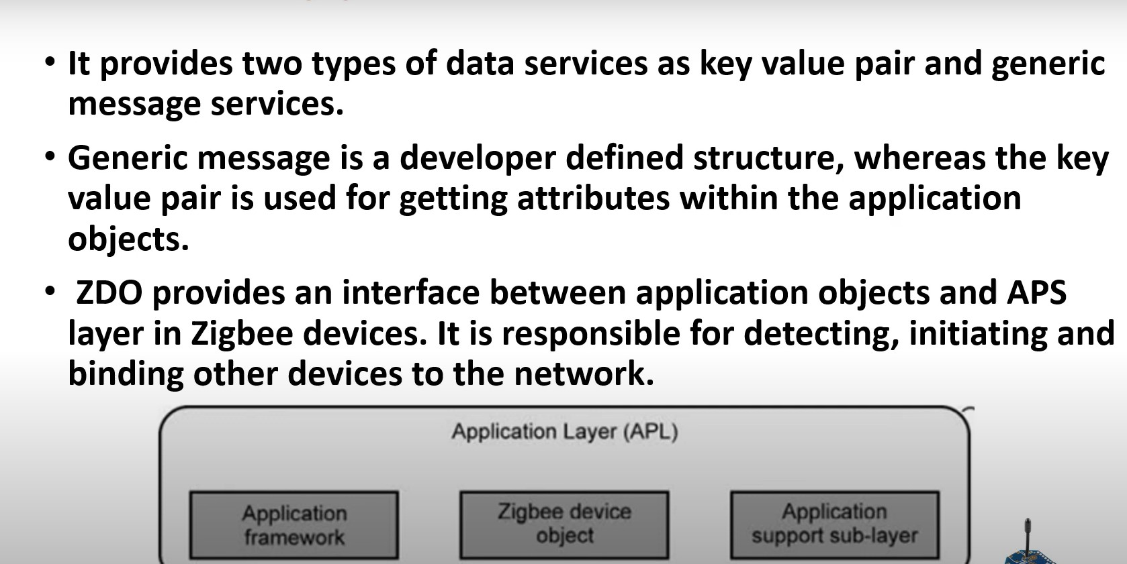
Application Layer

Slide 74
The ZigBee network and security layer provides mechanisms for network startup, configuration,routing, and securing communications.
This includes calculating routing paths in what is often a changing topology, discovering neighbors, and managing the routing tables as devices join for the first time.
The network layer is also responsible for forming the appropriate topology, which is often a mesh but could be a star or tree as well.
Fromasecurityperspective,ZigBee utilizes 802.15.4 for security at the MAClayer, using the Advanced Encryption Standard (AES) with a 128-bit key and also provides security at the network and application layers.

Slide 75
ZigBee IP
With the introduction of ZigBee IP, the support of IEEE
802.15.4 continues, but the IP and TCP/UDP protocols and various other open standards are now supported at the network and transport layers.
The ZigBee-specific layers are now found only at the top of the protocol stack for the applications

Slide 76
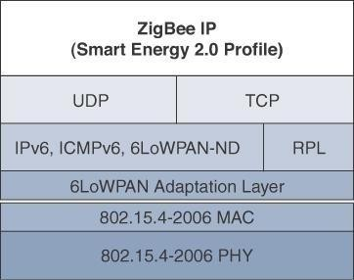
The ZigBee IP stack

Slide 77
ZigBee IP supports 6LoWPAN as an adaptation layer.
The 6LoWPAN mesh addressing header is not required as ZigBee IP utilizes the mesh-over or route-over method for forwarding packets.
ZigBee IP requires the support of 6LoWPAN’s fragmentation and header compression schemes.
Both TCP and UDP are also supported, to provide both
connection-oriented and connectionless service.

Slide 78
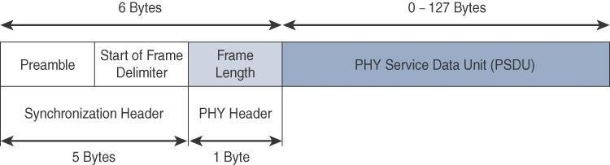
The frame for the 802.15.4 physical layer
The synchronization header for this frame is composed of the
Preamble and the Start of Frame Delimiter fields
The Preamble field is a 32-bit 4-byte pattern that identifies the start of the frame and is used to synchronize the data transmission
The Start of Frame Delimiter field informs the receiver that frame contents start immediately after this byte.

Slide 79
The MAC layer achieves these tasks by using various predefined frame types
Four types of MAC frames are specified in 802.15.4:
Data frame:
Handles all transfers of data
Beacon frame:
Used in the transmission of beacons from a PAN coordinator
Acknowledgement frame:
Confirms the successful reception of a frame
MAC command frame:
Responsible for control communication between devices

Slide 80
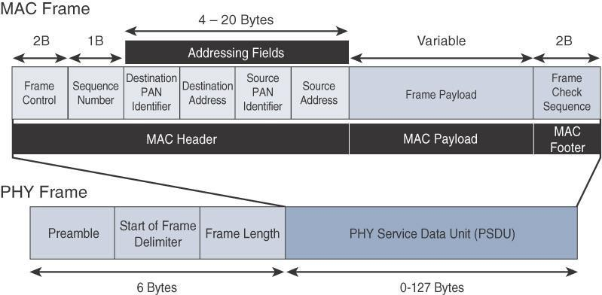
IEEE 802.15.4 MAC Format

Slide 81
Topology
IEEE 802.15.4–based networks can be built as star, peer-to- peer, or mesh topologies.
Mesh networks tie together many nodes.
This allows nodes that would be out of range if trying to communicate directly to leverage intermediary nodes to transfer communications.
Every 802.15.4 PAN should be set up with a unique ID.
All the nodes in the same 802.15.4 network should use the same PAN ID

Slide 82
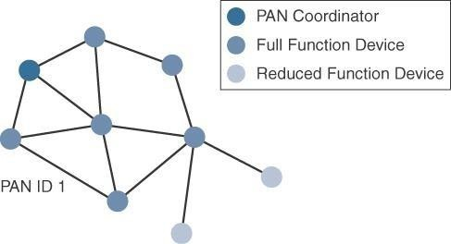

Slide 83
The IEEE 802.15.4 specification does not define a path selection within the MAC layer for a mesh topology.
This function can be done at Layer 2 and is known as mesh- under.
The routing function can occur at Layer 3, using a routing protocol, such as the IPv6 Routing Protocol for Low Power and Lossy Networks (RPL).
This is referred to as mesh-over

Slide 84
Security
The IEEE802.15.4 specification uses Advanced Encryption Standard (AES) with a 128-bit key length as the base encryption algorithm for securing its data
AES is a block cipher, which means it operates on fixed-size blocks of data
Symmetric key - means that the same key is used for both the encryption and decryption of the data
In addition to encrypting the data,AES in 802.15.4 also validates the data that is sent.
This is accomplished by a message integrity code (MIC), which is calculated for the entire frame using the same AES key that is used for encryption

Slide 85
Using the Security Enabled field in the Frame Control portion of the 802.15.4 header is the first step to enabling AES encryption.
This field is a single bit that is set to 1 for security.
Once this bit is set, a field called the Auxiliary Security Header is created after the SourceAddress field, by stealing some bytes from the Payload field.
The Auxiliary Security Header specifies information required for security processing and has a variable length.

Slide 86
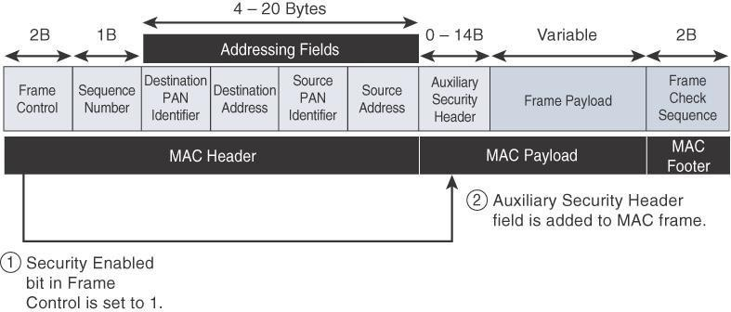
Frame Format with the Auxiliary Security Header Field for 802.15.4- 2006 and Later Versions

Slide 87
IEEE 802.15.4g and 802.15.4e
The IEEE 802.15.4e amendment of 802.15.4-2011 expands the MAC layer feature set to remedy the disadvantages associated with 802.15.4, including MAC reliability, unbounded latency, and multipath fading.
Also made improvements to better cope with certain application domains, such as factory and process automation and smart grid.
IEEE 802.15.4e-2012 enhanced the IEEE 802.15.4 MAC
layer capabilities in the areas of frame format, security, determinism mechanism, and frequency hopping.

Slide 88
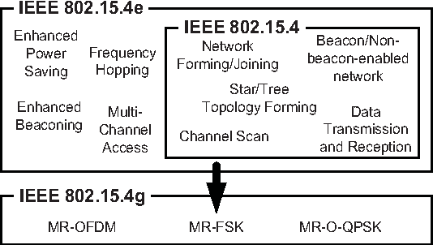

Slide 89
IEEE 802.15.4g-2012 is also an amendment to the IEEE 802.15.4-2011 standard
The focus of this specification is the smart grid or, more specifically, smart utility network communication.
802.15.4g seeks to optimize large outdoor wireless mesh networks for field area networks (FANs)

Slide 90
This technology applies to IoT use cases such as the following:
Distribution automation and industrial supervisory control and data acquisition (SCADA) environments for remote monitoring and control
Public lighting
Environmental wireless sensors in smart cities
Electrical vehicle charging stations
Smart parking meters
Microgrids
Renewable energy

Slide 91
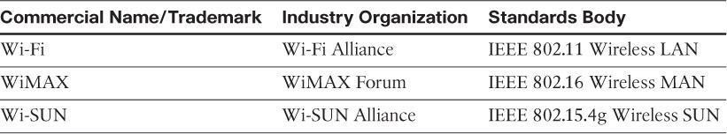
Standardization and Alliances
Toguarantee interoperability, the Wi-SUN Alliance was formed. (SUN stands for smart utility network.)

Slide 92
Physical Layer
PSDU(physical layer service data unit) or payload size of 127 bytes was increased for the SUN PHY to 2047 bytes
This provides a better match for the greater packet sizes found in many upper-layer protocols.
For example, the default IPv6 MTU setting is 1280 bytes.
The SUN PHY, supports multiple data rates in bands ranging from 169 MHz to 2.4 GHz
The error protection was improved in IEEE 802.15.4g.

Slide 93
Within these bands, data must be modulated (conversion of data into radio waves) onto the frequency using at least one of the following PHY mechanisms to be IEEE 802.15.4g compliant:
Multi-Rate and Multi-Regional Frequency Shift Keying (MR-FSK): Offers good transmit power efficiency due to the constant envelope of the transmit signal
Multi-Rate and Multi-Regional Orthogonal Frequency Division Multiplexing (MR-OFDM): Provides higher data rates but may be too complex for low- cost and low-power devices
Multi-Rate and Multi-Regional Offset Quadrature Phase-Shift Keying (MR-O-QPSK): Shares the same characteristics of the IEEE 802.15.4-2006 O-QPSK PHY, making multi-mode systems more cost- effective and easier to design.
Enhanced data rates and a greater number of channels for channel hopping are available, depending on the frequency bands and modulation

Slide 94
MAC Layer
Time-Slotted Channel Hopping (TSCH):
It is an IEEE802.15.4e-2012 MAC operation mode that works to guarantee media access and channel diversity.
Channel hopping, also known as frequency hopping, utilizes different channels for transmission at different times.
TSCH divides time into fixed time periods, or ―time slots, which offer guaranteed bandwidth and predictable latency..
In a time slot, one packet and its acknowledgement can be transmitted, increasing network capacity because multiple nodes can communicate in the same time slot, using different channels.
A number of time slots are defined as a slot frame, which is regularly repeated to provide guaranteed access.
TSCH adds robustness in noisy environments and smoother coexistence with the other wireless technologies especially for industrial use case.

Slide 95
Information elements:
Information elements (IEs) allow for the exchange of information at the MAC layer in an extensible manner, either as header IEs (standardized) and/or payload IEs (private).
Specified in a tag, length, value (TLV) format, the IE field allows frames to carry additional metadata to support MAC layer services

Slide 96
Enhanced beacons (EBs):
EBs extend the flexibility of IEEE 802.15.4 beacons to allow the construction of application-specific beacon content.
This is accomplished by including relevant IEs in EB frames.
Some IEs that may be found in EBs include network metrics, frequency hopping broadcast schedule, and PAN information version.
Note: Beacon frames: It contains network information needed by a station before it can transmit a frame.

Slide 97
Enhanced beacon requests (EBRs):
Like enhanced beacons, an enhanced beacon request (EBRs) also leverages IEs.
The IEs in EBRs allow the sender to selectively specify the request of information.
Beacon responses are then limited to what was requested in the EBR.
For example, a device can query for a PAN that is allowing new devices to join or a PAN that supports a certain set of MAC /PHYcapabilities

Slide 98
Enhanced Acknowledgement:
The EnhancedAcknowledgement frame allows for the integration of a frame counter for the frame being acknowledged.
This feature helps protect against certain attacks that occur whenAcknowledgement frames are spoofed.

Slide 99
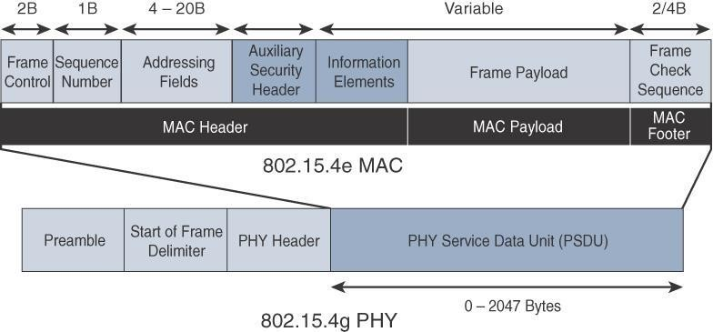
IEEE 802.15.4g/e MAC Frame Format

Slide 100
IEEE 802.15.4

Slide 101
The main changes shown in the IEEE 802.15.4e header are the presence of the Auxiliary Security Header and Information Elements field.
The Auxiliary Security header provides for the encryption of the data frame
The IE field contains one or more information elements that allow for additional information to be exchanged at the MAC layer.

Slide 102
Topology
Deployments of IEEE 802.15.4g-2012 are mostly based on a mesh topology
Mesh topology is typically the best choice for use cases in the industrial and smart cities areas
A mesh topology allows deployments to be done in urban or rural areas, expanding the distance between nodes that can relay the traffic of other nodes.

Slide 103
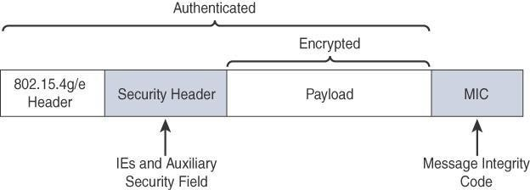
Security
Both IEEE802.15.4g and 802.15.4e inherit their security attributes from the IEEE 802.15.4-2006 specification.
Encryption is provided by AES, with a 128-bit key.
In addition to theAuxiliary Security Header field initially defined in 802.15.4-2006, a secure acknowledgement and a secure Enhanced Beacon field complete the MAC layer security

Slide 104
The full frame gets authenticated through the MIC at the end of frame.
The MIC is a unique value that is calculated based on the frame
contents.
The Security Header field denoted is composed of theAuxiliary Security field and one or more Information Elements fields.
Integration of the Information Elements fields allows for the
adoption of additional security capabilities, such as the IEEE
802.15.9 Key Management Protocol (KMP) specification.
KMP provides a means for establishing keys for robust datagram security

Slide 105
IEEE 1901.2a
IEEE1901.2a-2013 is a wired technology that is an update to the original IEEE 1901.2 specification.
This is a standard for Narrowband Power Line Communication (NB-PLC).
NB-PLC leverages a narrowband spectrum for low power, long range, and resistance to interference over the same wires that carry electric power.

Slide 106
NB-PLC is often found in use cases such as the following:
Smart metering:
NB-PLC can be used to automate the reading of utility meters, such as electric, gas, and water meters
Distribution automation:
NB-PLC can be used for distribution automation, which involves monitoring and controlling all the devices in the power grid.
Public lighting:
Common use for NB-PLC is with public lighting—the lights found in cities and along streets, highways, and public areas such as parks.
Electric vehicle charging stations:
NB-PLC can be used for electric vehicle charging stations, where the batteries of electric vehicles can be recharged.
Micro grids:
NB-PLC can be used for micro grids, local energy grids that can disconnect from the traditional grid and operate independently.
Renewable energy:
NB-PLC can be used in renewable energy applications, such as solar, wind power, hydroelectric, and geothermal heat.

Slide 107
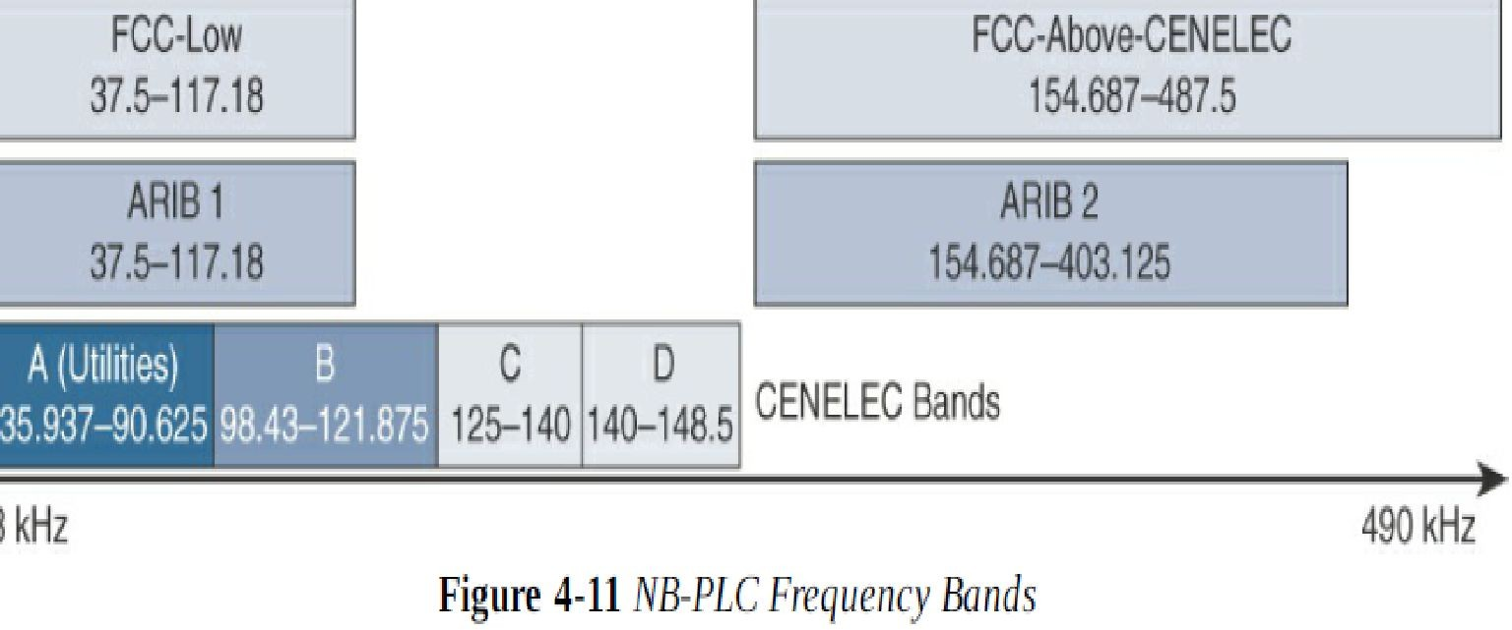
Physical Layer
NB-PLC is defined for frequency bands from 3 to 500 kHz. Much as with wireless sub-GHz frequency bands, regional regulations and definitions apply to NB-PLC.
The IEEE 1901.2a working group has integrated support for all world regions in order to develop a world wide standard.
CNELEC – is a European Committee for Electrotechnical Standardization. (standardizing the electrical engineering in Europe).
FCC – Federal communications commission, a US government organization which regulates the interstate and international communication.

Slide 108
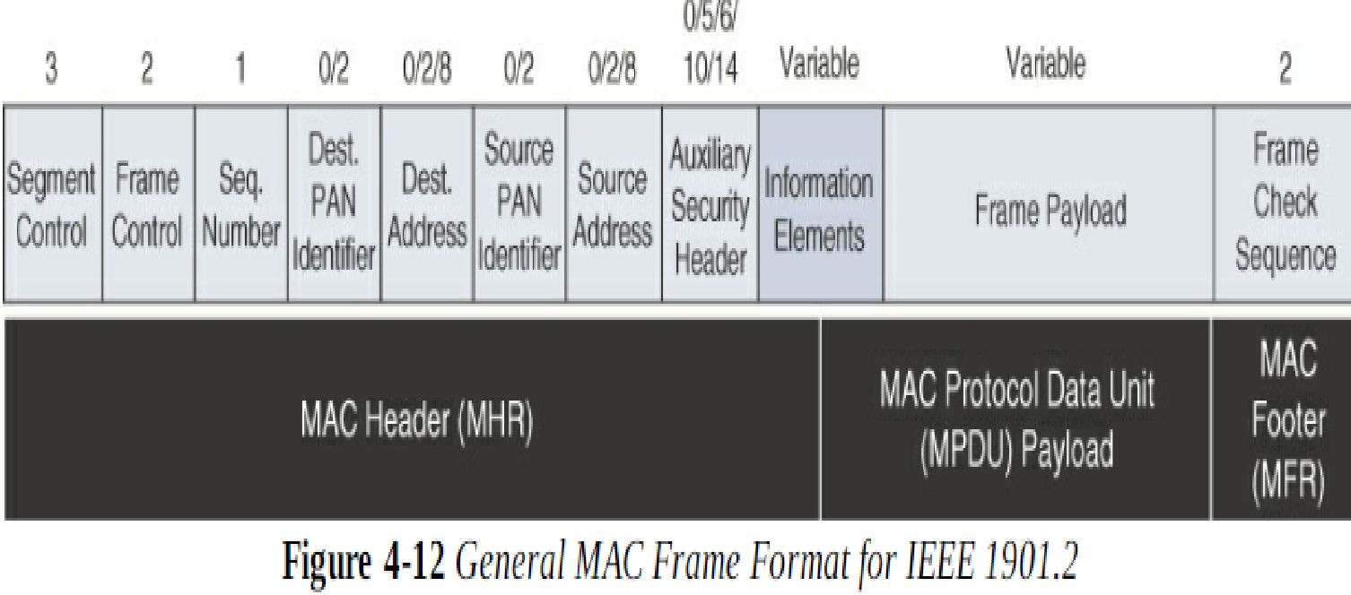
MAC Layer
The MAC frame format of IEEE 1901.2a is based on the IEEE 802.15.4 MAC frame but integrates the latest IEEE 802.15.4e-2012 amendment, which enables key features to be supported.
It has a Segment control field, handles the segmentation or fragmentation of upper layer packets with sizes larger than what can be carried in the MAC protocol data unit.

Slide 109
Security
The Security enabled bit in the Frame control bit should be set in all MAC frames carrying segments of an encrypted frame.
If data encryption is required, it should be done before packet segmentation.
On the receiver side, the data decryption is done after packet reassembly.
When security is enabled, the MAC payload is composed of the ciphered payload and the Message integrity code (MIC) authentication tag for non-segmented payloads.

Slide 110
IEEE 802.11ah
In unconstrained networks, IEEE 802.11 Wi-Fi is certainly the most successfully deployed wireless technology
IEEE 802.11 working group launched a task group named IEEE 802.11ah to specify a sub-GHz version of Wi-Fi.
Three main use cases are identified for IEEE 802.11ah
Sensors and meters covering a smart grid: Meter to pole, environmental/agricultural, Monitoring, industrial process sensors, indoor healthcare system and fitness sensors, home and building automation sensors
Backhaul aggregation of industrial sensors and meter data: Potentially connecting IEEE 802.15.4g sub networks
Extended range Wi-Fi: For outdoor extended-range hotspot or cellular traffic offloading when distances already covered by IEEE 802.11a/b/g/n/ac are not good enough

Slide 111
Physical Layer
IEEE 802.11ah essentially provides an additional 802.11 physical layer operating in unlicensed sub-GHz bands. Based on OFDM modulation, IEEE 802.11ah uses channels of 2, 4, 8, or 16 MHz
MAC Layer
The IEEE 802.11ah MAC layer is optimized to support the new sub-GHz Wi-Fi PHY while providing low power consumption and the ability to support a larger number of endpoints. Enhancements and features specified by IEEE 802.11ah for the MAC layer.
Enhancements and features specified by IEEE 802.11ah for the MAC include the following:
Number of devices
MAC header
Null data packet(NDP) support: Is extended to cover several control and management frames.
Grouping and sectorizations: Enables an AP to use sector antennas and also group stations.
Restricted access window(RAW): Is a control algorithm that avoids simultaneous transmission when many devices are present and provide fair access to the wireless network.

Slide 112
6. Target wakeup time(TWT): Reduces energy consumption by permitting an access point to define times when a device can access the network.
7. Speed frame change: Enables an AP and endpoint to exchange frames during a reserved transmit opportunity.

Slide 113
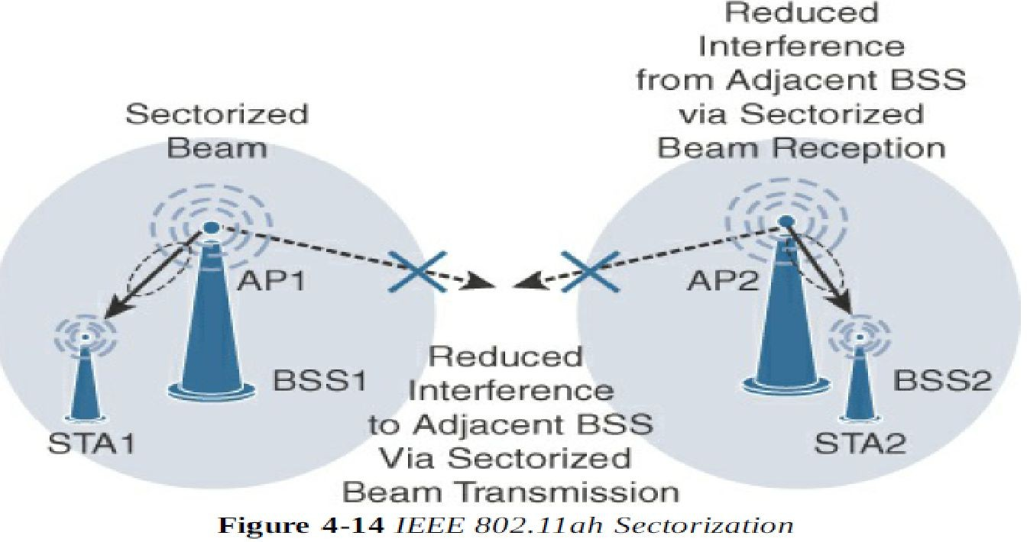
Topology
While IEEE 802.11ah is deployed as a star topology, it includes a simple hops relay operation to extend its range. This relay option is not capped, but the IEEE 802.11ah task group worked on the assumption of two hops.

Slide 114
LoRaWAN
Low-PowerWide-Area (LPWA) adapted for long-range and battery powered endpoints
LoRaWAN is unlicensed-band LPWAtechnology
LoRa was a physical layer, or Layer 1, modulation that was developed by a French company named Cycleo
Later, Cycleo was acquired by Semtech
Optimized for long-range, two-way communications and low power consumption

Slide 115
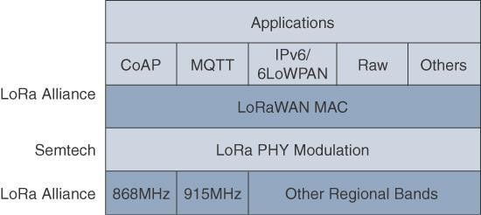
LoRaWAN Layers
The Constrained Application Protocol, is a specialized internet application protocol for constrained devices. It was designed to allow small, low-power devices to join the Internet of Things (IoT). The protocol allows these devices to communicate with the wider Internet using minimal resources.
MQTT: MQ Telemetry Transport protocol is a set of rules that defines how IoT devices can publish and subscribe to data over the Internet.

Slide 116
Physical Layer
Semtech LoRa modulation is based on chirp spread spectrum modulation
Chirp - Compressed High Intensity Radar Pulse
Lower data rate and increase the communication distance
A LoRa gateway is deployed as the center hub of a star network architecture.
It uses multiple transceivers and channels and can demodulate multiple channels at once or even demodulate multiple signals on the same channel simultaneously.
LoRa gateways serve as a transparent bridge relaying data between endpoints, and the endpoints use a single-hop wireless connection to communicate with one or many gateways.

Slide 117
The data rate in LoRaWAN varies depending on the frequency bands and adaptive data rate (ADR).
ADR is an algorithm that manages the data rate and radio signal for each endpoint.
The ADR algorithm ensures that packets are delivered at the best data rate possible and that network performance is both optimal and scalable.
An important feature of LoRa is its ability to handle various data rates via the spreading factor.
Devices with a low spreading factor (SF) achieve less distance in their communications but transmit at faster speeds, resulting in less airtime.
A higher SF provides slower transmission rates but achieves a higher reliability (making networks more secure against cyber threats and intelligent edge-based data storage and computation.) at longer distances.

Slide 118
MAC Layer
The MAC layer is defined in the LoRaWAN specification.
This layer takes advantage of the LoRa physical layer and classifies LoRaWANendpoints to optimize their battery life and ensure downstream communications to the LoRaWAN endpoints.
The LoRaWAN specification documents three classes of LoRaWAN devices:
Class A:
This class is the default implementation. Optimized for battery powered nodes, it allows bidirectional communications, where a given node is able to receive downstream traffic after transmitting.
Two receive windows are available after each transmission

Slide 119
Class B:
This class was designated ―experimental‖ in LoRaWAN 1.0.1 until it can be better defined.
A Class B node or endpoint should get additional receive windows compared to ClassA, but gateways must be synchronized through a beaconing process
Class C:
This class is particularly adapted for powered nodes.
This classification enables a node to be continuously listening by keeping its receive window open when not transmitting.

Slide 120

LoRaWANmessages, either uplink or downlink, have a PHY payload composed of a 1-byte MACheader, a variable-byte MAC payload, and a MIC that is 4 bytes in length.
The MAC payload size depends on the frequency band and the data rate, ranging from 59 to 230 bytes for the 863–870 MHz band and 19 to 250 bytes for the 902–928 MHz band

Slide 121
In version 1.0.x, LoRaWAN utilizes six MAC message types.
LoRaWAN devices use join request and join accept messages for activation and joining the network.
The other message types are unconfirmed data up/down and confirmed data up/down.
A―confirmed‖ message is one that must be acknowledged, and
―unconfirmed‖signifies that the end device does not need to acknowledge.
―up/down‖ is simply a directional notation identifying whether the message flows in the uplink or downlink path.
Uplink messages are sent from endpoints to the network server and are relayed by one or more LoRaWAN gateways.
Downlink messages flow from the network server to a single
endpoint and are relayed by only a single gateway

Slide 122
LoRaWAN endpoints are uniquely addressable through a variety of methods, including the following:
An endpoint can have a global end device ID or DevEUI represented as an IEEE EUI-64 address.
An endpoint can have a global application ID or AppEUI represented as an IEEE EUI-64 address that uniquely identifies the application provider, such as the owner, of the end device

Slide 123
In a LoRaWAN network, endpoints are also known by their end device address, known as a DevAddr, a 32-bit address.
The 7 most significant bits are the network identifier (NwkID), which identifies the LoRaWAN network.
The 25 least significant bits are used as the network address (NwkAddr) to identify the endpoint in the network.

Slide 124
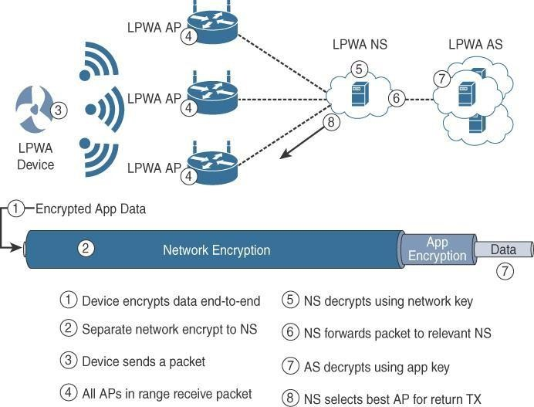
Security

Slide 125
LoRaWAN endpoints must implement two layers of security, protecting communications and data privacy across the network.
The first layer, called ―network security‖ but applied at the MAC layer, guarantees the authentication of the endpoints by the LoRaWAN network server.
Also, it protects LoRaWANpackets by performing encryption based onAES

Slide 126
Each endpoint implements anetwork session key (NwkSKey), used by both itself and the LoRaWAN network server.
The NwkSKey ensures data integrity through computing and checking the MIC of every data message as well as encrypting and decrypting MAC-only data message payloads
The second layer is an application session key (AppSKey), which performs encryption and decryption functions between the endpoint and its application server

Slide 127
LoRaWAN endpoints attached to a LoRaWAN network must get registered and authenticated.
This can be achieved through one of the two join mechanisms:
Activation by personalization (ABP):
Endpoints don’t need to run a join procedure as their individual details, including DevAddr and the NwkSKeyand AppSKey session keys, are preconfigured and stored in the end device.
This same information is registered in the LoRaWAN network server

Slide 128
Over-the-air activation (OTAA):
Endpoints are allowed to dynamically join a particular LoRaWAN network after successfully going through a join procedure.
The join procedure must be done every time a session context is renewed.
During the join process, which involves the sending and receiving of MAC layer join request and join accept messages, the node establishes its credentials with a LoRaWANnetwork server, exchanging its globally unique DevEUI, AppEUI, andAppKey.
TheAppKey is then used to derive the session NwkSKey and
AppSKey keys

Slide 129
NB-IoT and Other LTE(long term evolution) Variations
Existing cellular technologies, such as GPRS, Edge, 3G, and 4G/LTE, are not particularly well adapted to battery- powered devices and small objects specifically developed for the Internet ofThings
LTE -M
LTE-M or LTE-MTC ("Long-Term Evolution Machine Type Communication"), is a type of low-power wide-area network radio communication technology standard developed by 3GPP(3rd generation partnership project) for machine-to-machine and Internet of Things (IoT) applications. A new narrowband radio access technology called Narrowband IoT (NB-IoT)

Slide 130
It addresses the requirements of a massive number of low- throughput devices, low device power consumption, improved indoor coverage, and optimized network architecture.

Slide 131
LTE Cat 0
The first enhancements to better support IoT devices in 3GPP occurred in LTE Release 12.
A new user equipment (UE) category, Category 0, was added, with devices running at a maximum data rate of 1 Mbps
Category 0 includes important characteristics to be supported by both the network and end devices.

Slide 132
Power saving mode (PSM)
This new device status minimizes energy consumption
PSM is defined as being similar to ―powered off‖mode, but the device stays registered with the network.
By staying registered, the device avoids having to reattach or re- establish its network connection
The device negotiates with the network the idle time after which it will wake up.
When it wakes up, it initiates a tracking area update (TAU), after which it stays available for a configured time and then switches back to sleep mode or PSM.
A TAU is a procedure that an LTE device uses to let the network know its current tracking area, or the group of towers in the network from which it can be reached

Slide 133
Half-duplex mode
This mode reduces the cost and complexity of a device’s implementation because a duplex filter is not needed.
Most IoT endpoints are sensors that send low amounts of data that do not havea full duplex communication requirement.

Slide 134
LTE-M
LTE Release 13
Lower receiver bandwidth
Bandwidth has been lowered to 1.4 MHz versus the usual 20 MHz.This further simplifies the LTE endpoint
Lower data rate
Data is around 200 kbps for LTE-M, compared to 1 Mbps for Cat 0.

Slide 135
Half-duplex mode
Just as with Cat 0, LTE-M offers a half-duplex mode that decreases node complexity and cost
Enhanced discontinuous reception (eDRX)
This capability increases from seconds to minutes the amount of time an endpoint can ―sleep between paging cycles

